Slide 1
Digital Dream Team
| Keith Camp | Mohammed Al Madhi | Joseph Baxter | Kyle Cousin | Eric Lopez | Matthew Smith |
Client: UofL Office of Research and Innovation

Slide 2
Agenda
Site Issues
Solutions
Strategies
Site technology
Website DEMO
Summary
Questions

Slide 3
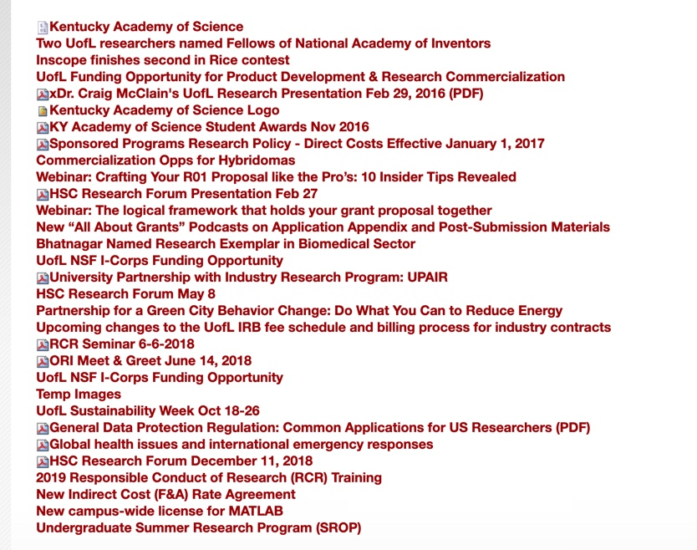
Issue #1– User Interface
Many pages on the site have cluttered UI elements and lists that could make it difficult for users to navigate and locate the correct information
Additionally, some of these pages contain dead links and outdated information

Slide 4
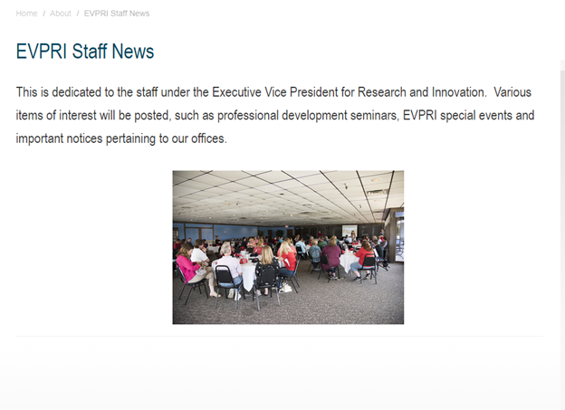
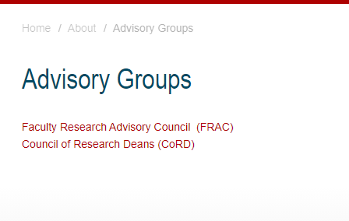
Issue #2 - Empty Pages
Numerous pages on site that contain little to no information
Increases the page count of the site
Makes navigation more complicated
Link: https://louisville.edu/research/about/staffnews
Link: https://louisville.edu/research/about/advisorygroups

Slide 5
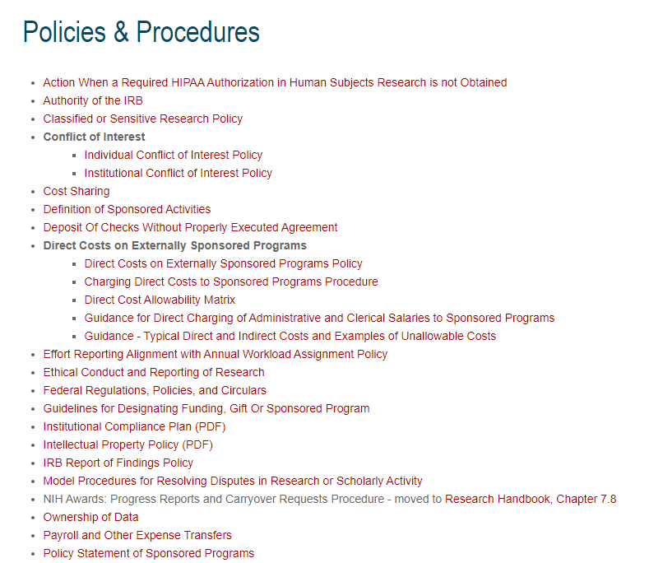
Issue #3- Information Overload
Lists of links and a lack of organization make it difficult to find the information needed.
Link : https://louisville.edu/research/policies/

Slide 6
solutions
Redesign R&I website using WordPress
Widely used CMS
Easy to edit layout
Easy to add content
Consistent page layouts
Reorganize site navigation
Combine less dense pages
Break up cluttered pages
Organized lists
Reorganize information

Slide 7
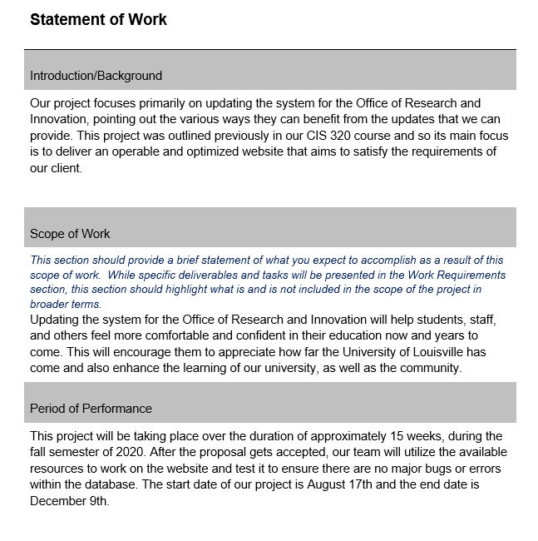
Strategies – Team Charter/work statement
Document outlining how development will proceed
Meetings
Responsibilities
Milestones
Scope

Slide 8
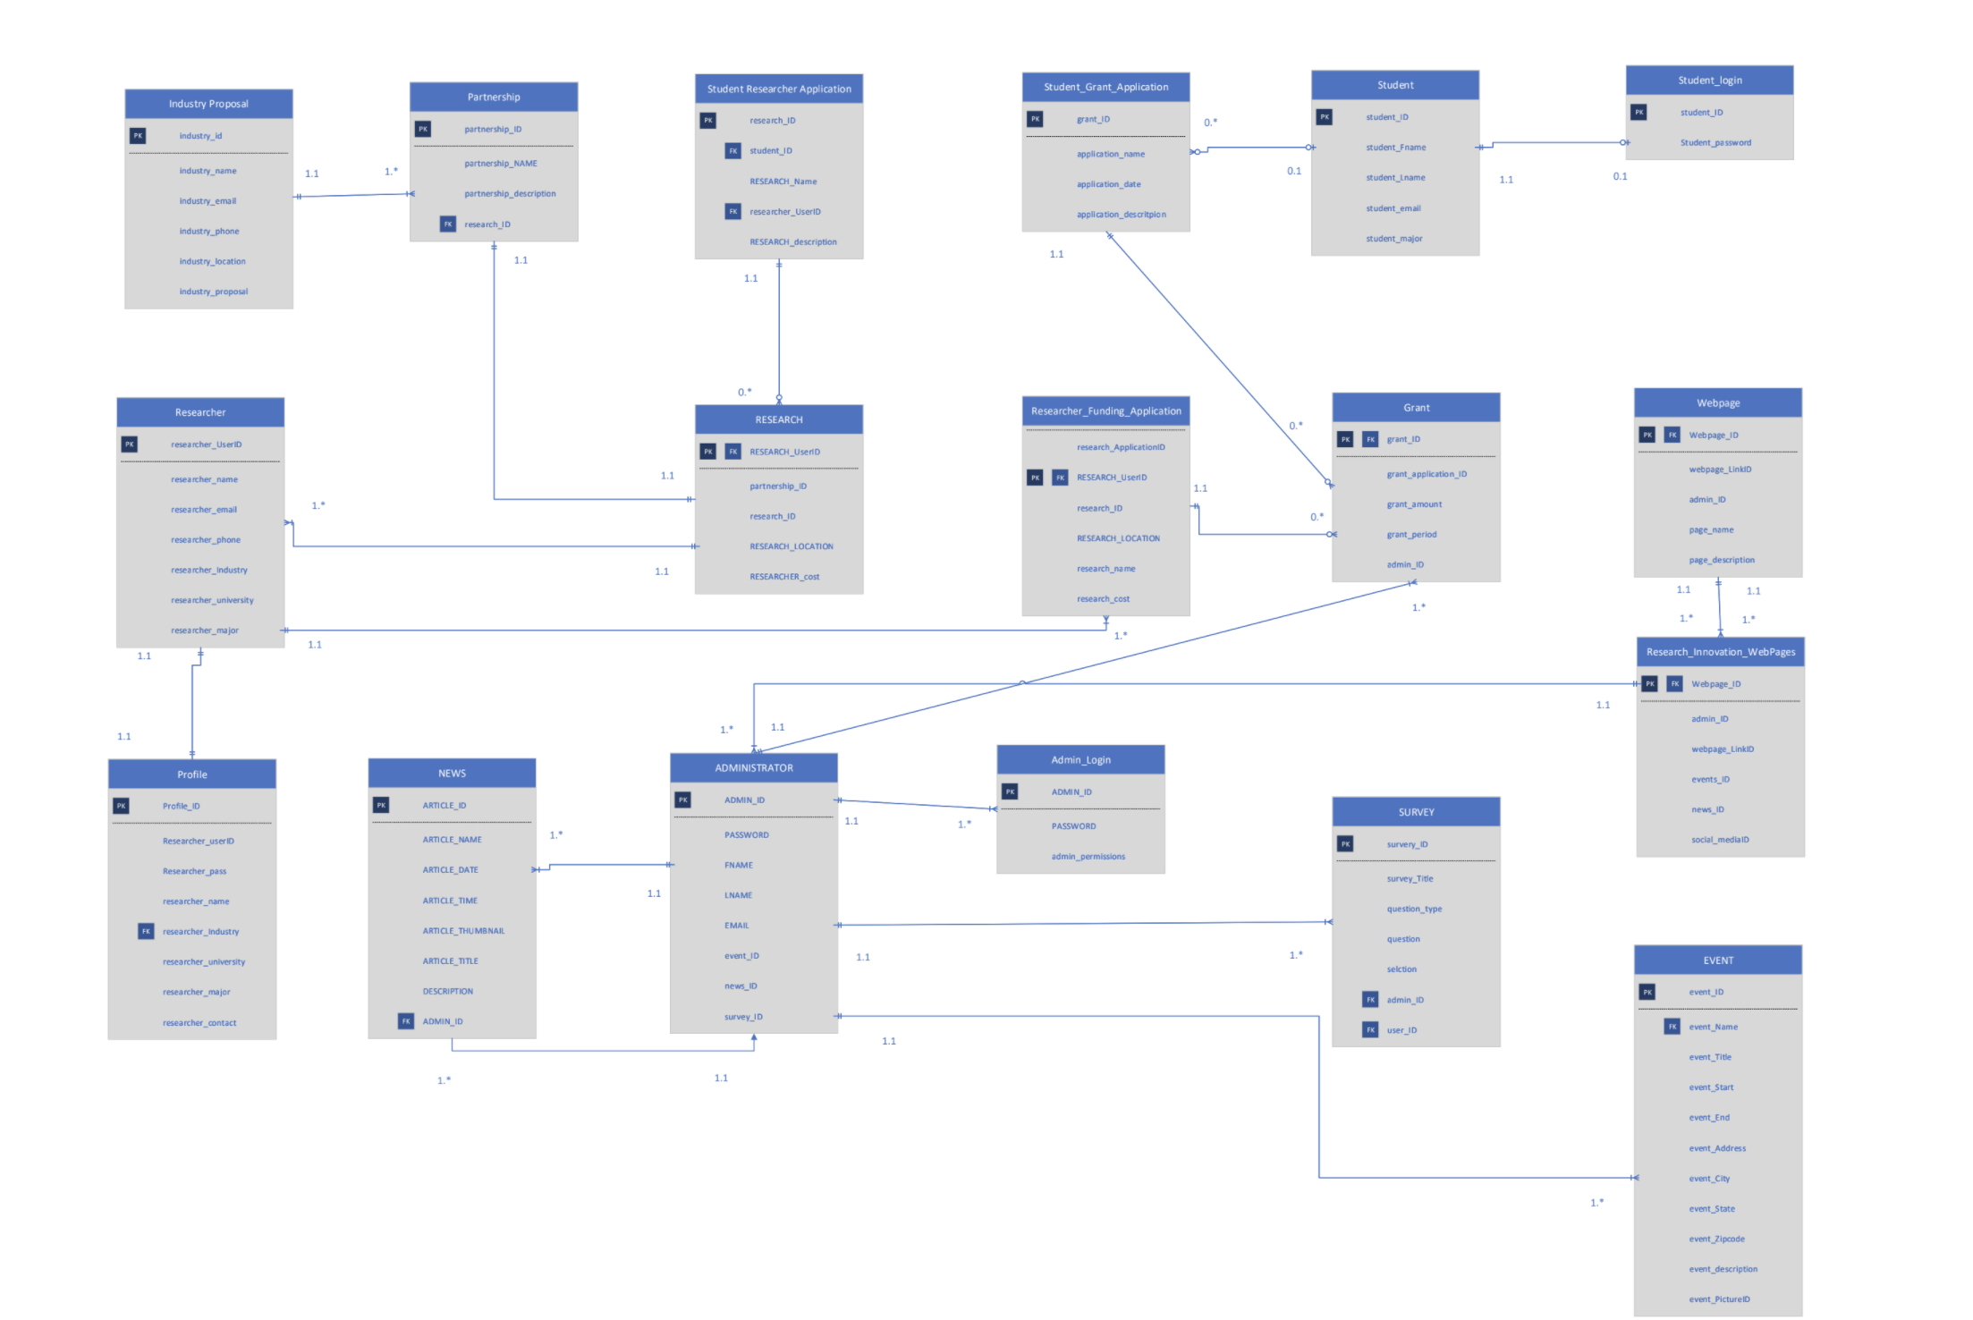
Strategies – Defined Business Rules
Entity Relationship Diagram (ERD)
Maps the relationships between the entities that comprise the site and its interactions
Notes:
Here you explain that strategies we used to tackle the issues with the website, we first created the Business rules and from that we built an ERD, then we made our Project Charter and lastly created prototypes to develop the site based on that. (She Asked for Images of each, I can't fit all the images on here)

Slide 9
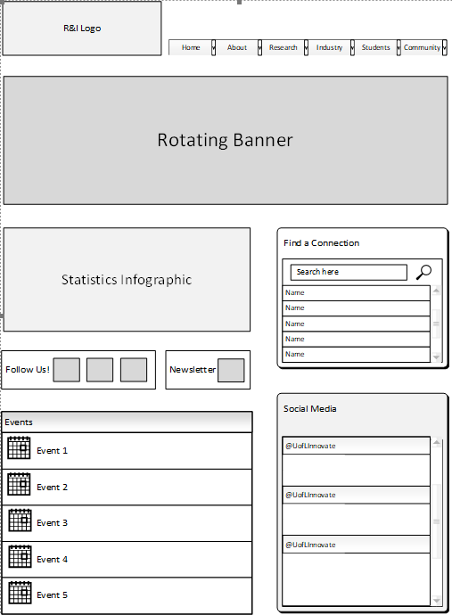
Strategies – Wire Frames
Non-functional mockups to help plan a cohesive design

Slide 10
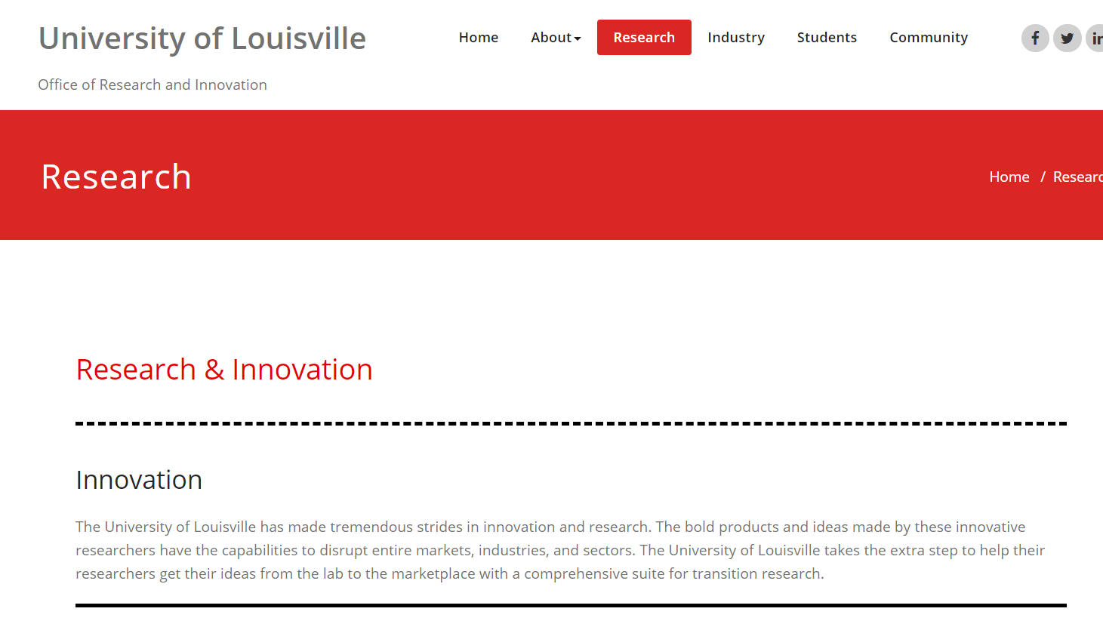
Strategies - Prototypes
Created from wire frames
Implemented on a second test domain where we can see how our designs could be improved

Slide 11
Technology
WordPress
Theme - Appointment Red
Events Calendar Plugin – helps us Create/Edit and Post events to our website
WPForm – Assists us with creating a contact us form that was implemented on our About us page.
Hubspot - secondary form creation tool for forms that may need to be updated frequently
Hosted on Sharkhosting.co.uk

Slide 12
Overview of the functionality of the website
www.DigitalDreamTeam.xyz

Slide 13
Summary
User interface, empty pages, information overload
Redesign
Concise navigation
Lowered page count
Less clutter
Notes:
Restated the Issues as suggested.

Slide 14
Contact us
Keith Camp – keith.camp@louisville.edu
Joseph Baxter – jcbaxt02@louisville.edu
Mohammed Al Madhi – mohammed-almadhi@louisville.edu
Kyle Cousin – kyle.cousin@louisville.edu
Mathew Smith – mathew.smith@louisville.edu
Eric Lopez-Gutierrez – eric.lopezguitierrez@louisville.edu

